Slide 1
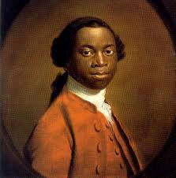
Olaudah Equiano
Writing Prompt

Slide 2
Grading
Type 1 Writing:
  5 points for completion
Type 2 Writing:
  1 point for stating your opinion
  3 points for each reason (9 pts. total)
  Total of 15 points

Slide 3
Things to Remember….
For ALL type 1 and type 2 writings:
  Write down the title (Type 1 or Type 2) and the prompt itself
  Follow ALL directions
        Type 1
        Copy down the writing prompt.
          Sentence 1
          Sentence 2
          Sentence 3

Slide 4
Type 1 Writing
How would you feel if you were taken far from your home by people you never saw before?
Must be three complete sentences
Leave a space between each sentence

Slide 5
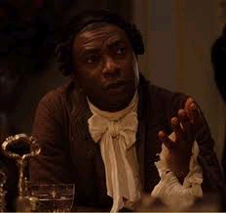
Background Information
Who was Equiano?
How could he write?
How did he become free?

Slide 6
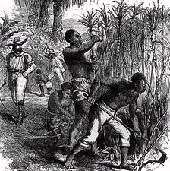
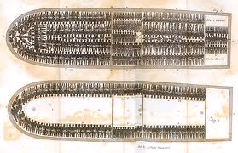
Now READ the excerpt….

Slide 7
Discussion Questions
What did Equiano think the white men were?
What did Equiano think the white men were going to do to him?
What drink did the slave traders give Equiano to revive him? Did it work?
Why do you think Equiano prefers slavery in Africa?

Slide 8
Discussion Questions
How does Equiano describe the area which the slaves were kept?
What does Equiano wish for?
What happened when he refused to eat?
Why did they care is he was eating or not?
When and where was this book published?
Is this a primary or secondary source?

Slide 9
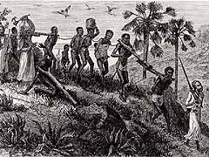
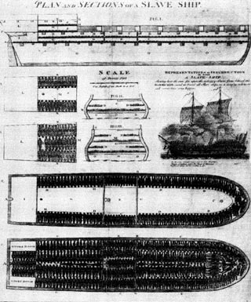

Slide 10
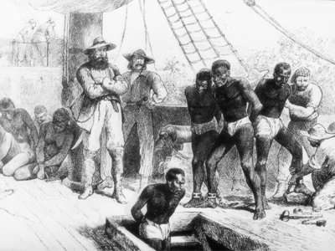

Slide 11
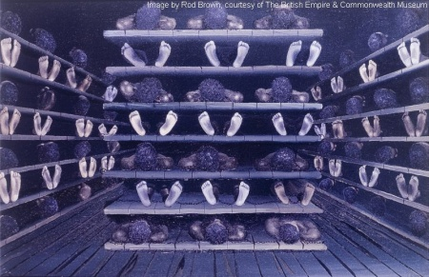

Slide 12
Type 2 Writing
Do you think Equiano’s account of his ordeal was accurate?
Underline three reasons why you think it was or was not accurate.
Respond in 5-6 sentences
Things to know
  Equiano wrote his account roughly 30 years after it happened.
  Also remember he was only 11 years old at the time of capture.
  However does someone forget something so traumatic?

